Slide 1

Psychology Perspectives

Slide 2
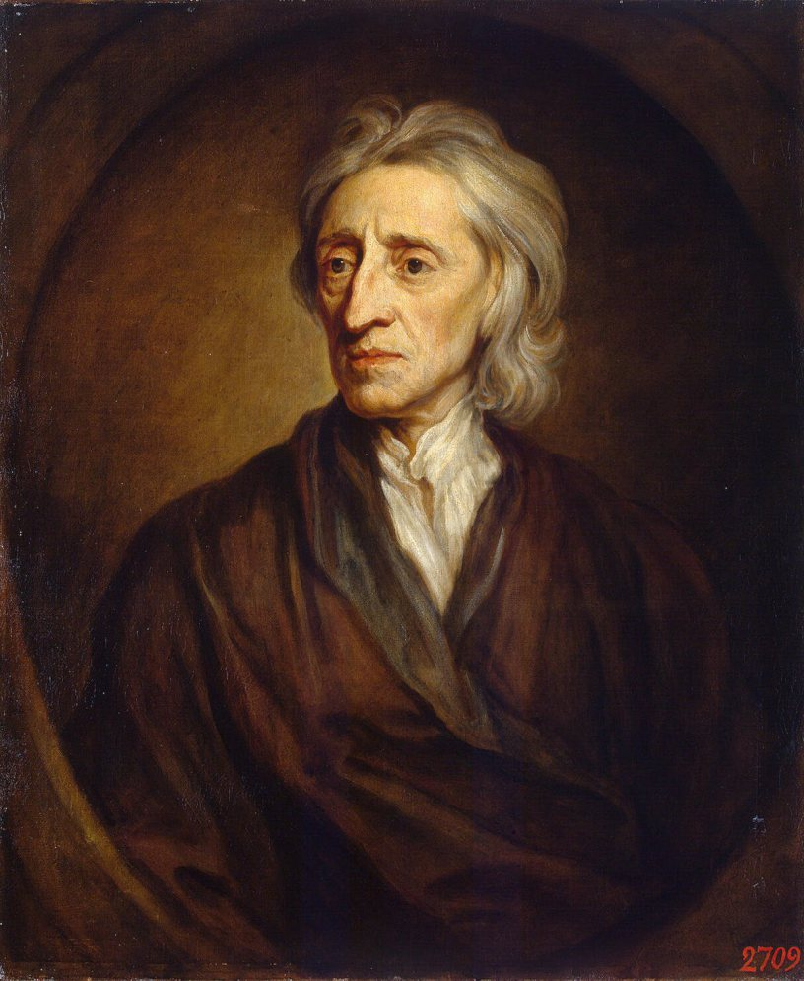
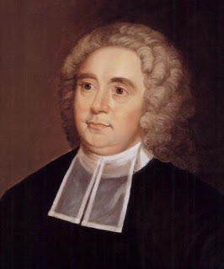
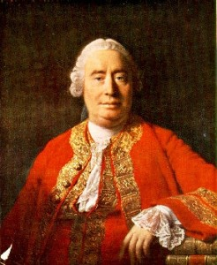
John Locke
George Berkeley
David Hume

Slide 3
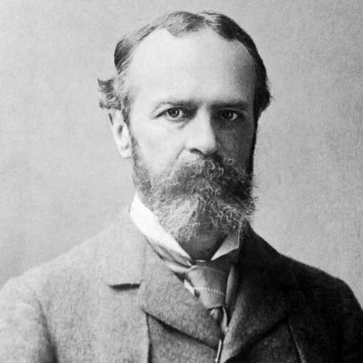
William James
Introspection

Slide 4
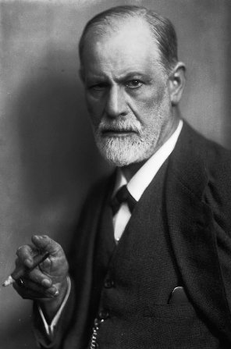
Psychodynamic Perspective
Sigmund Freud
The Unconscious

Slide 5
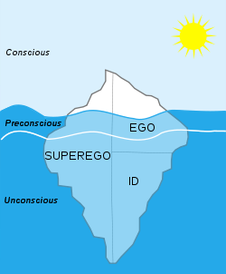
Freud’s Theory of Personality

Slide 6
Stage | Age Range | Erogenous zone(s) | Consequences of Fixation
Oral | 0-1 years | Mouth | Orally aggressive: Signs include chewing gum or ends of pens. Orally Passive: Signs include smoking/eating. Fixation at this stage may result in passivity, gullibility, immaturity and manipulative personality
Anal | 2-3 years | Bowel and bladder elimination | Anal retentive: Obsession with organization or excessive neatness Anal expulsive: Reckless, careless, defiant, disorganized, Coprophiliac
Phallic | 4-6 years | Genitals | Oedipus complex (in boys only according to Freud) Electra complex (in girls only, later developed by Carl Jung)
Latency | 7-10 years (until puberty) | Dormant sexual feelings | (People do not tend to fixate at this stage, but if they do, they tend to be extremely sexually unfulfilled.)
Genital | 11+ years (Puberty and beyond) | Sexual interests mature | Frigidity, impotence, unsatisfactory relationships
Freud’s Theory of Psychosexual Development

Slide 7
Freud’s Theory of Mental Illness
New Stage
Conflict
Unresolved Conflict
Defense Mechanism
Resolution
Subconscious
Next Stage
Mental Illness Symptoms - Neuroses

Slide 8
Personal Bias
Unscientific
Unrepresentative Sample
Male Bias
Observer Bias
Unfalsifiable
Lack of Evidence
Emphasis on Sex
Subjectivity

Slide 9
Other Psychodynamic Psychologists

Slide 10
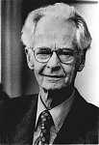
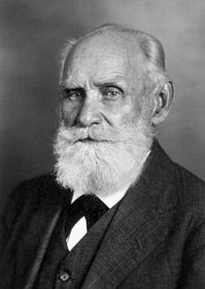
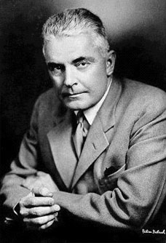
Behaviourist Perspective
Frank Skinner
Ivan Pavlov
John Watson

Slide 11
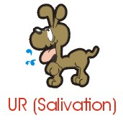

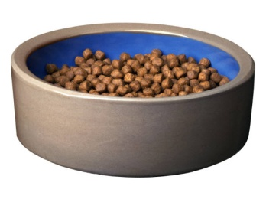
Pavlov’s Dogs – Classical Conditioning
Unconditioned
Response
Unconditioned
Stimulus
Neutral
Stimulus

Slide 12
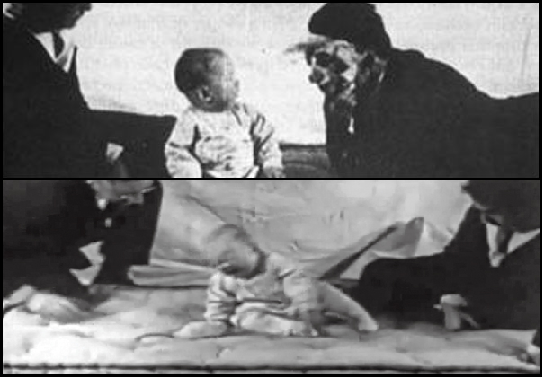
Little Albert – Classical Conditioning

Slide 13
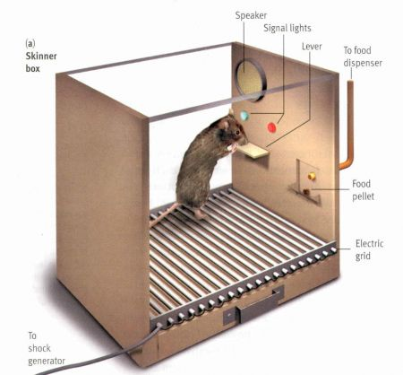
Skinner’s Box – Operant Conditioning

Slide 14
Scientific
Limiting
Falsifiable
Simplistic
Measurable
Objective
Inadequate Explanation
Rigorous

Slide 15
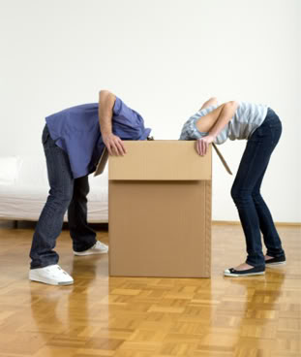
Cognitive Approach – Looking Inside The Black Box

Slide 16
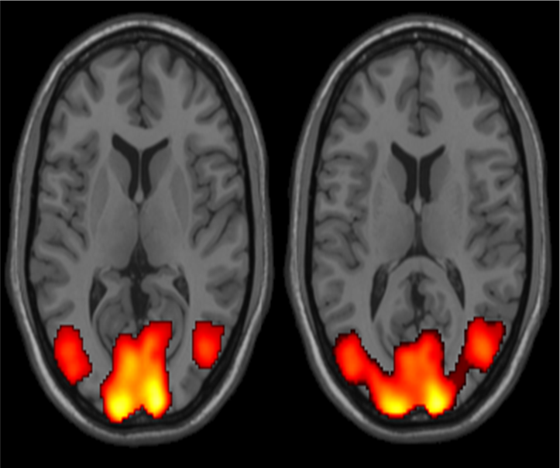
Physiological Approach – Looking at the Brain Working

